Slide 1
Logistic Regression
Yanjun PU

Slide 2
Data set Introduction
features
label
Data set: SPAM E-mail Database
Features: 57
Label: 0/1
Number of spam instances:
1,813 39.4%
Number of non-spam instance:
2,788 60.6%
Total of records :
4,601
57 columns
1 column

Slide 3
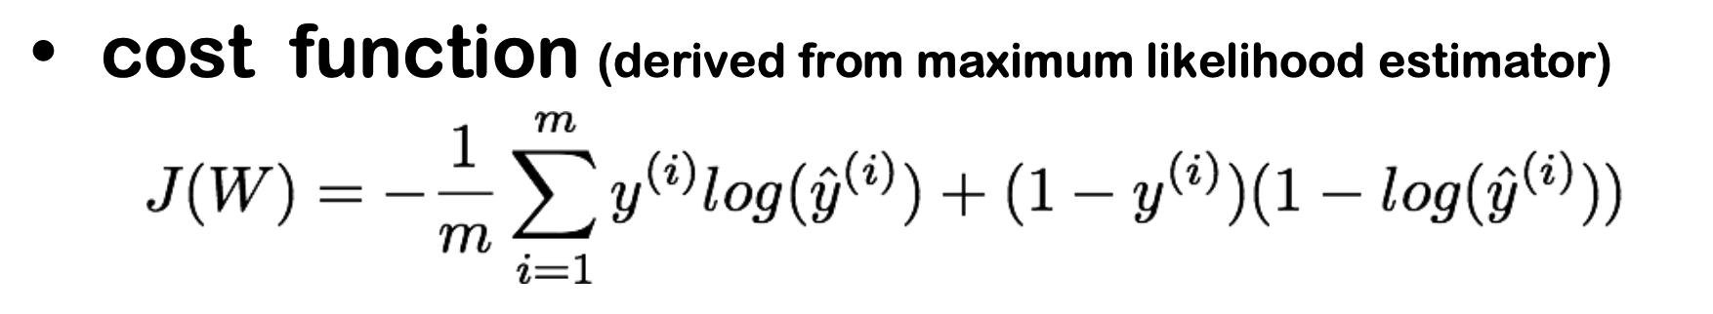
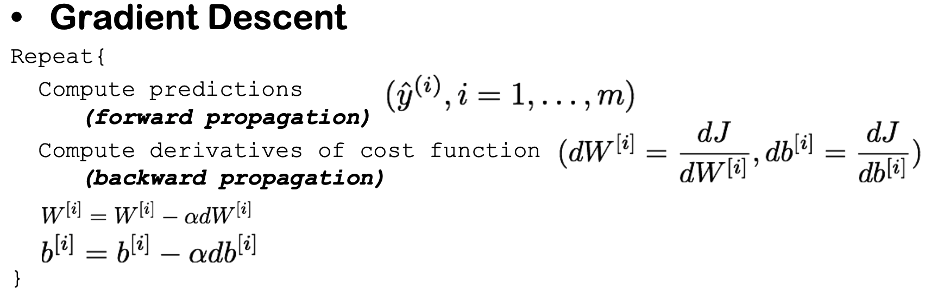
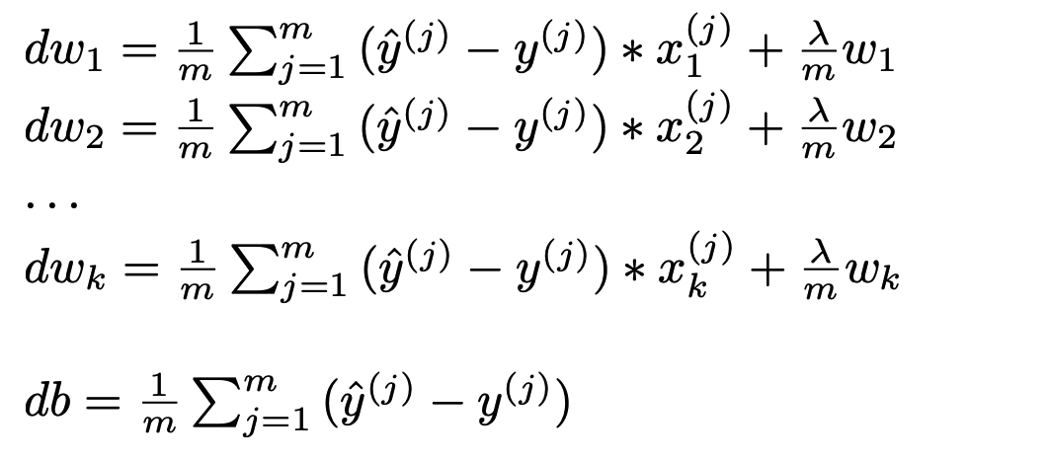
Logistics Regression
.Derivatives

Slide 4
Standardize - pyspark
x- mean
_______
x_standardized =
std
def standardize (RDD_Xy):
global col_sum -> record the sum of each column
global averages -> record the average of each column
global stds -> record the standard Deviation of each colum
col_sum = RDD_Xy.reduce(sumReducer)[0]
averages = calculate_averages(N_COLS,N_ROWS,col_sum)
sigmas = RDD_Xy.map(residuesMapper).reduce(sumReducer)[0]
stds = calculate_stds(N_COLS,N_ROWS,sigmas)
rdd = RDD_Xy.map(standardizeMapper)
rdd.count()
return rdd

Slide 5
Cross Valiation
Shuffle Data
def shuffle_transfrom(RDD_Xy:pyspark.RDD,k_fold = 10):
weights = np.ones(k_fold)
weights = weights.tolist()
RDD_folds = RDD_Xy.randomSplit(weights,6)
return RDD_folds
Shuffle Data in Spark
Split to K - folds
Train and Test Split
Train Set
Test set

Slide 6
Training- procedure
initialize weights and bias
training iteration
#propagation
RDD_Xzy = RDD_Xy.map(y_estimated_mapper)
#calculate Cost
cost = calculate_cost(RDD_Xzy,lambda_reg)
#calculate deviation
dw = calculate_gradients(RDD_Xzy,lambda_reg)
db = calculate_db(RDD_Xzy)
#gradient descent
w,b = update_weights(w,b,dw,db,learning_rate)

Slide 7
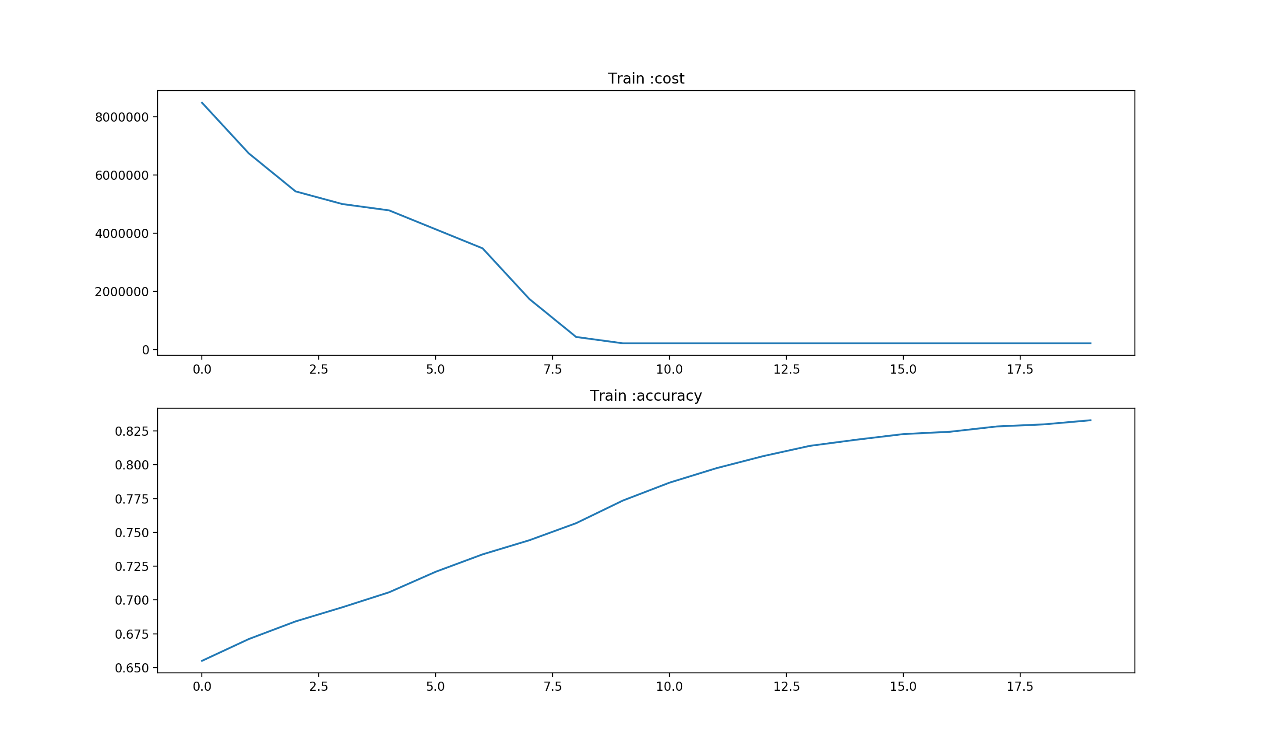
Centralized Version-performance
iteration | Learning_rate | Lambda_reg
20 | 0.7 | 0.2
time cost(s) 14.756101846694946
accuracy 0.86333

Slide 8
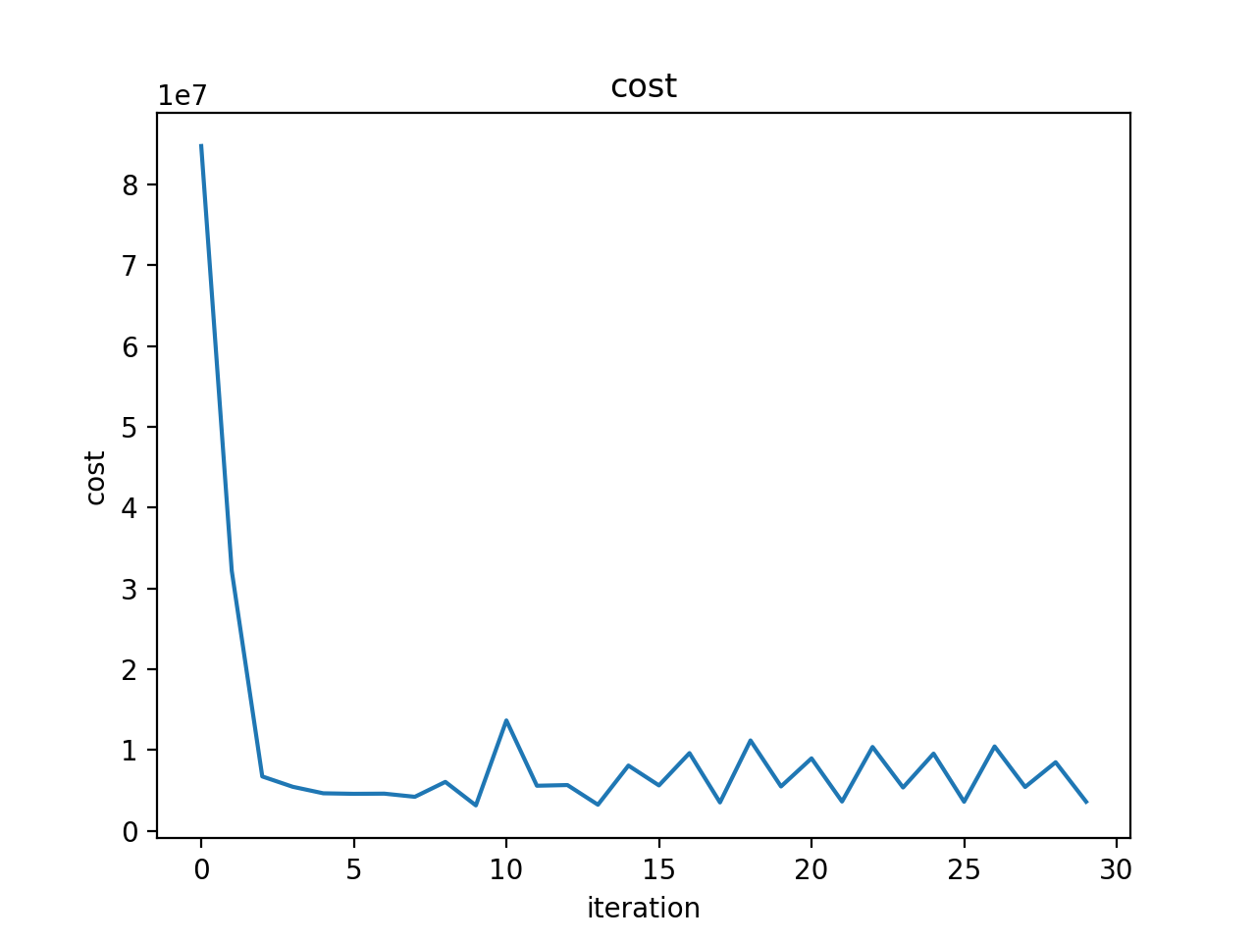
Spark Version-performance
iteration | Learning_rate | Lambda_reg
30 | 0.7 | 0.2
cross validation k-fold | Average Accuracy
10 one-hot | 0.85673

Slide 9
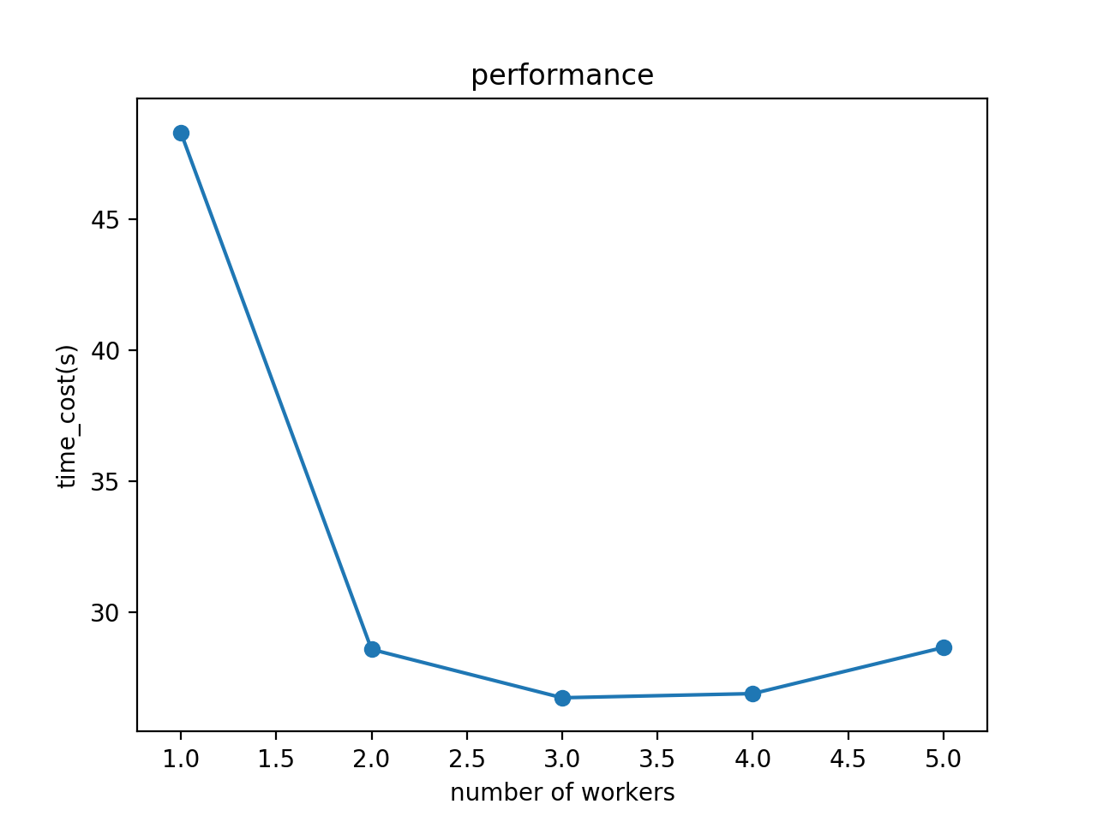
Perfomance Curve with n workers
The laptop running this program only has 4 cores.
So, The performance improve with the increase of number or workers.But when the number of workers is more than 4.
The performance donesn't improve but even become worse.

